Slide 1
TEST DESIGN
Test design is a stage of the quality process, during which we create test scenarios and it's a way how to write test case to get a maximum of test coverage and save a lot of testing time
Разработка тестов - это этап процесса обеспечения качества, во время которого мы создаем тестовые сценарии, и это способ написания тестового примера, чтобы получить максимальный охват тестированием и сэкономить много времени на тестирование.

Slide 2
POPULAR TEST DESIGN TECHNIQUES IN SOFTWARE TESTING
Equivalence Class Partitioning
Классы Эквивалентности
Boundary Value Analysis (BVA)
Граничные Значения
State Transition
Тестирование Состояний и Переходов
Decision Table based testing.
Таблица Принятия Решений
Pairwise testing
Метод Попарного Тестирования

Slide 3
Decision Table based testing. Таблица Принятия Решений
A decision table is also known as to Cause-Effect table. This software testing technique is used for functions which respond to a combination of inputs or events.

Slide 4
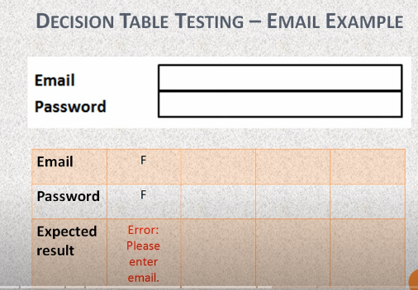
Example how build a decision table for a combination between password and email

Slide 5
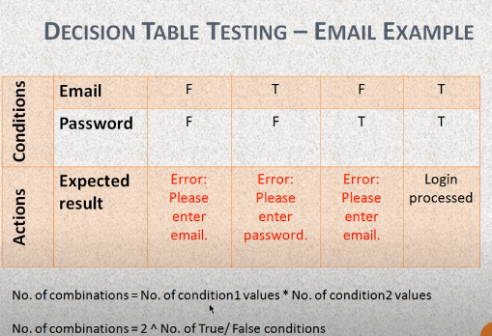
Email and password can be false or true and we need to know how many combination possible on our example Number of combination here is 2*2=4 because we have 2 condition of email(TorF)and 2 condition of password (TorF)

Slide 6
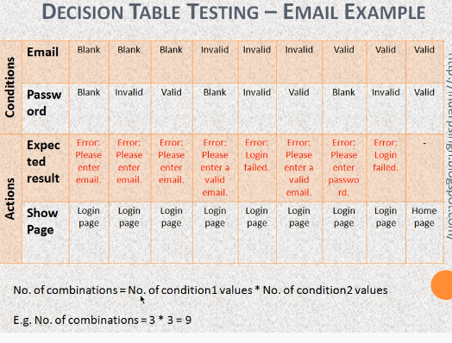
Here we choose 3 value of the email and the password (invalid valid and blank) that’s why our combination will be 3*3=9

